Slide 1


Rupee FX Modeling
Microsoft Team #3
Prepared for:
Jennifer Chisholm, Tom Bono, and Microsoft
Notes:
Thank you to tom, jennifer

Slide 2







GEORGETOWN MSF CONSULTING TEAM
Sameer Shaik
MSF ‘25
- Management and HR Experience
- MS in Management, Babson College
Eric Yunker
MSF ‘25
- Financial Analyst Experience
- Bachelors in Technology and Business Management, Arizona State University
ss5055@georgetown.edu
Luis Hernandez
MSF ‘25
- Associate, Morgan Stanley
- Bachelor’s in Financial Economics, Spring Hill College
ey204@georgetown.edu
Kenneth Moore
MSF ‘25
- EVP, Graduate Investment Fund
- Bachelor's in Economics, University of Colorado
lah163@georgetown.edu
Emily Lin
MSF ‘25
- Compliance Analyst, Webull Financial
- Bachelor’s in Economics, New York University
khm64@georgetown.edu
el993@georgetown.edu
Microsoft Team 3
Notes:
Drop the part time
Start with good morn, hi etc

Slide 3
Executive Summary
Goal of the Project
Help visualize, forecast, and utilize historical exchange rate trends,exchange rate volatility, and risk exposure.
Microsoft Surface Re-pricing strategy
1
Microsoft Team 3’s FX Model
Summarize the additions made to the current model
Review - inputs & outputs of the ARIMA and SARIMA
How Microsoft can use the model to improve their forecasting/decision making
2
Showcase the model
Analyze overall currency trends
Backtesting example
Effect of future use
3
Microsoft Team 3
Notes:
While Accuracy is not possible because of how volatile the Indian Rupee is, we will be using Techniques that can provide insights into what might happen
Feedback
What is the punchline – audience should have main takeaway from exec summary

Slide 4




Our Agenda
India Overview
Our Approach
Regression And Time Series Analysis
Microsoft Surface Repricing Strategy
Notes:
Highlight component and use as transition slide
We will start by covering an overview on India Geopolitical and economic factors and how they affect the the INR/USD exchange rate
Next we will cover the approach, which will highlight the process we took collecting data, forecasting exchange rates, Implemented AI, and applied it to microsoft products in india
We will then discuss all the regression and time series models we have designed, as well as what key learnings we have found from each of them.
Finally we will apply our findings from our analytics to strategize the pricing of the microsoft surface to minimize Revenue dilution, caused by Exchaneg rate fluctuations

Slide 5

India Overview
India Overview
Our Approach
Regression And Time Series Analysis
Microsoft Surface Repricing Strategy
Microsoft Team 3
Notes:
-Inukclude an agenda…
-Use segway slide as a transition
-”we chose the rupee because of…”

Slide 6



India PEST Backdrop
Political
Economic
Social
Technological
BJP
5th
28.4
850
Has pushed for nationalistic policies
Largest economy in the world
Median age across India
Million internet users last year
This has and will continue to affect trade policies and import duties in order to promote domestic production.
Still considered an emerging market, making it the 2nd largest.
The younger demographic presents a significant workforce and consumer base.
The younger demographic presents a significant workforce and consumer base.
Microsoft Team 3
Notes:
Political: Parliamentary System. Geopolitical tensions with China and Pakistan. Federal vs State policies. GST amendments
Economic: 22% of the population is below the poverty line. 65% of the population resides in rural areas. 1.4 Billion people, 18% of the world’s population.
Social: Urban population is expected to grow to over 600 million by 2030. Caste system continues to influence social and economic mobility.
Technological: Global hub for tech and innovation. Automation and technological advancements changing the job market
Feedback – Unified Format

Slide 7
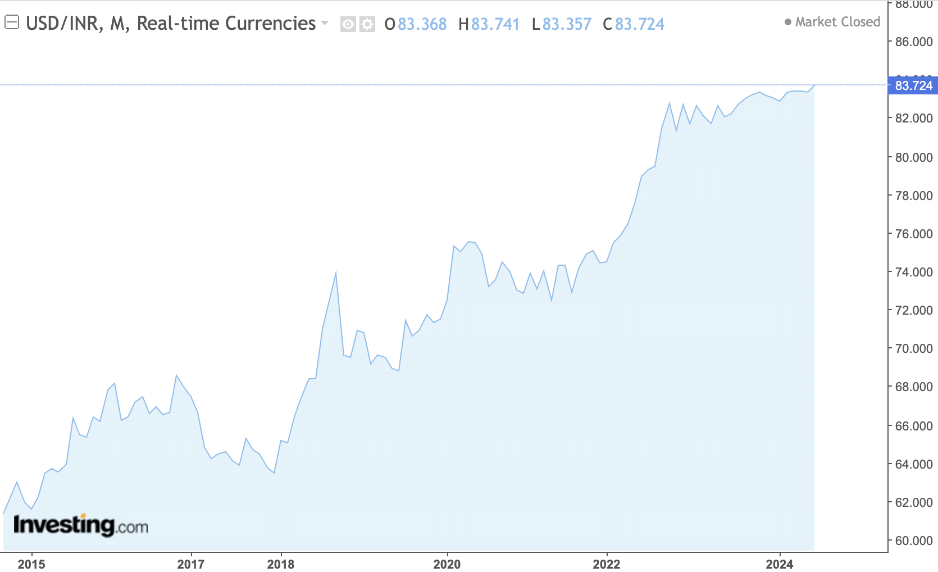
Characteristics of the Rupee FX Market
Capital Controls
Regulating money flow to stabilize Rupee.
Volatility
Oil prices, trade balance, and investor sentiment.
Economic Fundamentals
Growth, inflation, and current account.
Government Interventions
Buying and selling currencies and adjusting interest rates.
Microsoft Team 3
Notes:
Allude to independent variables in the models
Put something in the middle - exchange rate graph
Capital Controls
The Indian government uses capital controls to regulate money flow. Goals: stabilize the rupee, protect industries, manage external debt. Drawbacks: hinder foreign investment, slow financial market development.
Economic Fundamentals
Indian economy's health (growth, inflation, current account balance) affects rupee's value. Strong fundamentals strengthen the rupee. Weaknesses lead to depreciation.
Government Intervention
Government interventions in the foreign exchange market influence the rupee's value. Methods: buying/selling currencies, adjusting interest rates. Goals: manage volatility, promote economic growth, control inflation.
Volatility
The Indian Rupee experiences significant value fluctuations. Influencing factors: global oil prices, trade balance, investor sentiment.
The Indian government has a history of implementing capital controls to restrict the flow of money into or out of the country. These controls aim to stabilize the rupee, protect domestic industries, and manage external debt. However, they can also hinder foreign investment and financial market development.
The overall health of the Indian economy, including factors like growth, inflation, and current account balance, significantly impacts the rupee's value. Strong economic fundamentals inspire confidence in the currency, leading to a stronger rupee. Conversely, weaknesses can lead to depreciation.
Government interventions in the foreign exchange market, such as buying or selling currencies or adjusting interest rates, can influence the rupee's value. These policies aim to achieve short-term goals like managing volatility or long-term goals like promoting economic growth and controlling inflation.

Slide 8
Our Approach
India Overview
Our Approach
Regression And Time Series Analysis
Microsoft Surface Repricing Strategy
Microsoft Team 3
Notes:
Talk about the asrima models

Slide 9
FX Model
Past Teams’ Model Capabilities (2020 MS team 3 XBL)
ARIMA Model for time series analysis and forecasting
Scenario analysis determining the total events of price changes
Our Improvements
Implementation of various indicators
Regression analysis to choose significant and strongly correlated indicators
ARIMA Model implementation
Predict spot rate based on % change of indicators
AI Implementation for regression, spot rate prediction, and ARIMA
Microsoft Team 3
Microsoft Team 3
Notes:
Move this slide
-mention that this is Inspiration from Microsoft team 3 XBL from 2020

Slide 10
Our Process
01
Key indicators
Regression analysis
Time series analysis
Forecast the USD / INR Exchange rate
02
Implement back testing and regression formulas
Develop accurate predictive models for INR/USD exchange rates
AI Based Prediction
03
Balance revenue dilution and accretion in exchange rate fluctuations
Provide recommendations : Exchange rate pricing
Re-Strategize Microsoft Surface Pricing in India
Microsoft Team 3
Notes:
Forecast the Exchange Rate of the INR/USD
Predicted Via specifically chosen Indicators that show correlation with changes in the INR/USD Exchange rate
Regression Tested Indicators - USA and India CPI + GDP, and the Dollar Index
Train AI to predict Exchange Rate forecast
Backtesting and Regression Formula
Re-strategize the pricing of the Microsoft Surface Based on AI Output
AI Findings on Exchange rate and how that affects Microsoft Surface Pricing
Goal - Minimize Revenue dilution of the Microsoft surface from FX change
Scope - INR vs USD
Our Recommendation - Banding ___%, ___% Threshold, Regression/ARIMA hybrid Model
Inspired by 2020 Microsoft Team 3 Project - XBL and FX of indian rupee
Pricing Evaluation and restructuring of XBL
Forecast INR/USD Exchange rate to create profitability of selling XBL

Slide 11
Regression & Time Series Analysis
India Overview
Our Approach
Regression & Time Series Analysis
Microsoft Surface Repricing Strategy
Microsoft Team 3

Slide 12





Predictor Variables
Variable | Why?
Trade Balance of India and U.S. | Trade Surplus/Deficits can affect demand for a country’s currency causing it to appreciate/depreciate.
Dollar Index | This is a measure of the U.S. dollar value relative to a basket of foreign currencies. (Euro, Japanese Yen, Pound, Canadian Dollar, Swedish Krona and Swiss Franc)
Crude Oil World Price | Rising Oil prices can make it more expensive to import oil causing large deficits
U.S. and India CPI (Consumer Price Index) | Increasing CPI indicates inflation meaning that the currency is depreciating.
U.S. and India Interest Rates | Higher interest rates attract more foreign capital (ROI increases), higher interest rates also can combat inflation
Microsoft Team 3
Notes:
Parity conditions

Slide 13
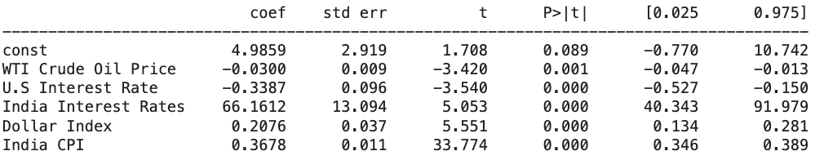
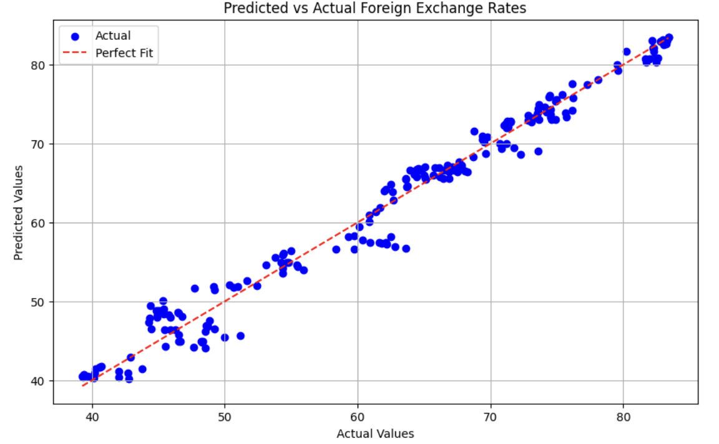
Regression Model
vs Predicted
R-squared=.976
Prediction Expression: 4.98-0.029 x WTI Crude Oil Price-0.338* U.S. Interest Rate+.6616 x India Interest Rate+0.207 x Dollar Index+0.367 x India CPI
Microsoft Team 3
Notes:
Last 12 months for the regression model
Projection of test period
2007-2022 sample fit
2023 test
2024 forecast
Trends > preciseness
Techniques that provide INSIGHTS
Write down how the exchange rate is expressed ( dollar to Rupee)

Slide 14
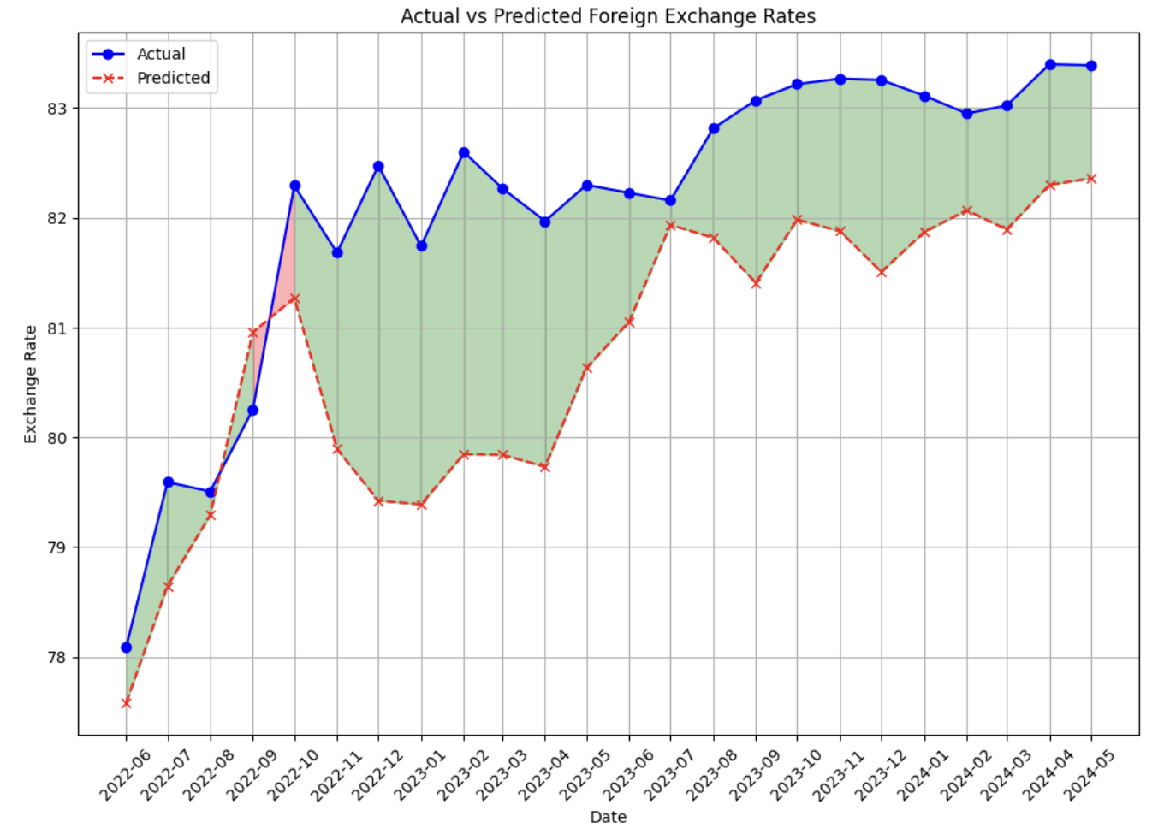
Regression Testing Period
Avg % Difference= 1.64%
Microsoft Team 3
Notes:
Graph is too busy- get rid of % difference numbers but still discuss it
Speculate because of gvmt intervention-our model is consistently underpredicting depreciation by 1.6% . as a team we speculate that the model might be biased, or there might be a lot of speculated government intervention
Directionally correct but underestimating.

Slide 15
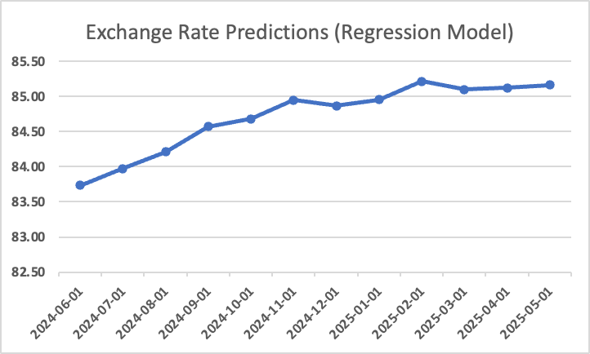
Regression Prediction
Microsoft Team 3

Slide 16
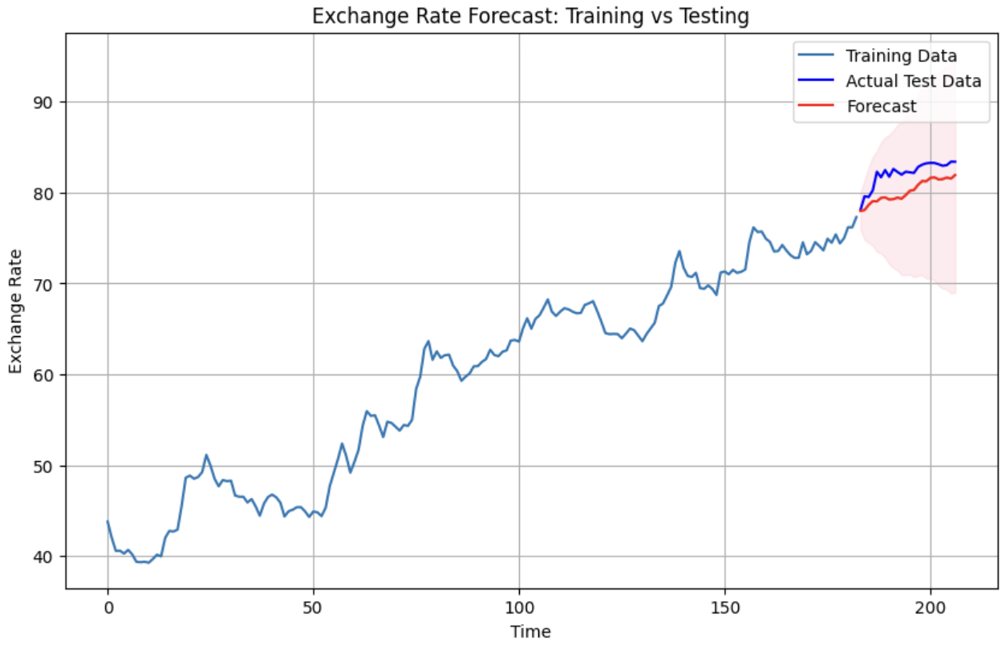
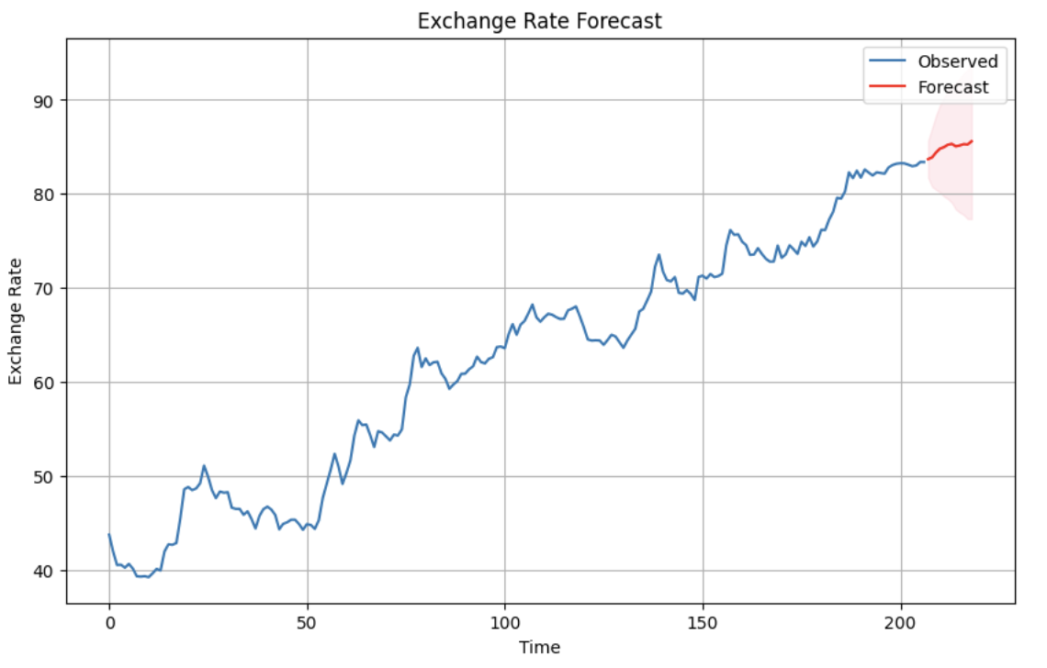
SARIMA Model
SARIMAX (0,1,1)x(0,1,1,12)
Microsoft Team 3
Notes:
-add explanation as to what was done to get - testing periods, etc - a couple extra slides

Slide 17
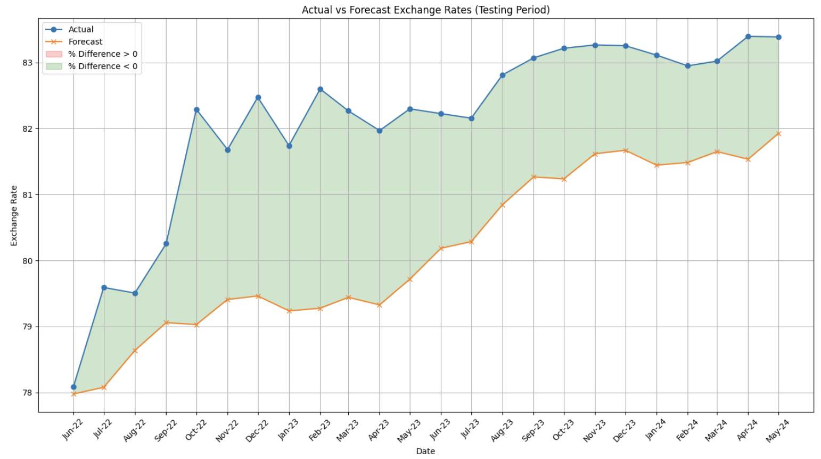
SARIMA Testing Period
Avg Difference= 2.40%
Avg % Difference= 2.40%
Microsoft Team 3
Notes:
Harp on the fact that we are continuing to do underestimates

Slide 18
Microsoft Surface Repricing Strategy
India Overview
Our Approach
Regression And Time Series Analysis
Microsoft Surface Repricing Strategy
Microsoft Team 3

Slide 19



Surface Repricing Approach
Current Microsoft Strategy
1 repricing event per year
Our Goal
Balance revenue accretion and dilution
Our
Recommendation
Select the optimal exchange rate (the balanced exchange rate over the forecasted period) to price the Surface
Notes:
Feedback
-
-Implement your learnigns from the models discussed and show how that data can help us predict a new price
- Change optimal exchange rates - to average exchange rate of the year
Increase font size
-average over predicted spot rate
-pricing at a higher point at the beginning of the year
Notes
Building on our forecasted exchange rates, we’ve created a repricing approach
From what we’ve learned from MSFT, they allow a maximum 1 repricing event per year
So our approach and recommendation is to use the optimal exchange rate to determine the pricing of the surface product
We achieve this by taking the average over the year. Based on our forecast, we expect the movement of the exchange rate to be below the average in the first half of the year and above the average in the second half
Which means that MSFT would be experiencing revenue accretion in the first half but revenue dilution in this second half of the year
Through this approach, our goal is to utilize a exchange rate that may potentially help MSFT balance revenue accretion and dilution

Slide 20
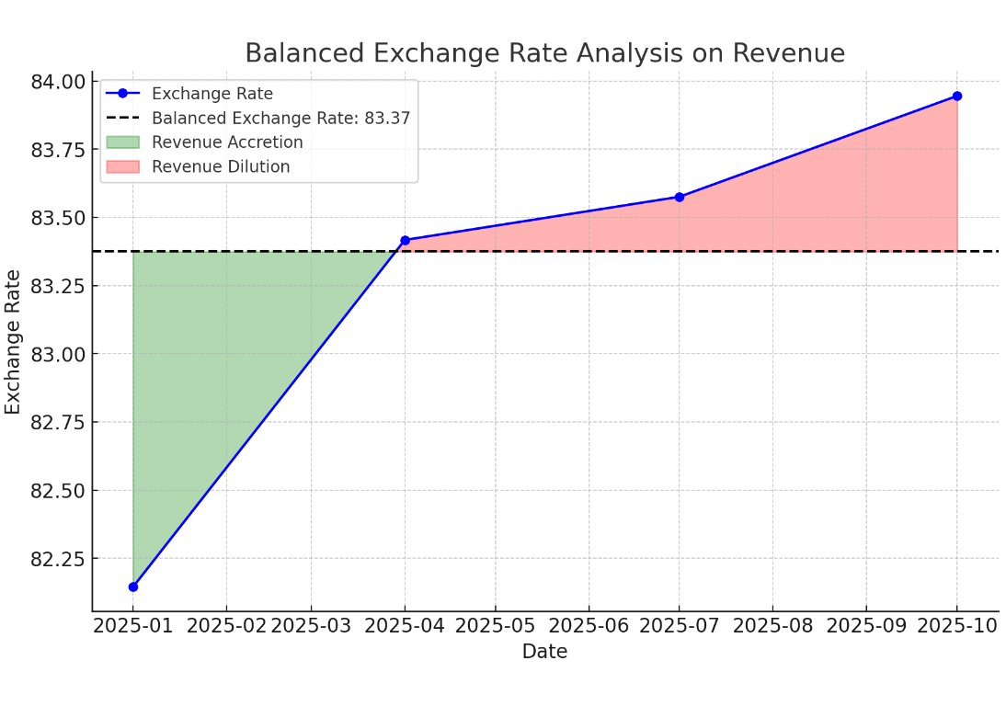
Surface Repricing Example
2025 Optimal Pricing of Surface
Estimated U.S. Surface Price 2025 | $1,200
Forecasted average spot rate for 2025 | 83.37
Avg GST | 30.2%
INR price including GST | 130,257.29
Notes:
Blow up the graph
For our repricing approach, we’ve provided an example of how this might look like for the 2025 Surface Pricing
Within the graph, on the red dot, you can see the 2025 average exchange rate of 83.27, which will be used to price the surface
Then we’ve created a 2% banding based on the average point
As you can see within this graph, within the first half of the year, those exchange rate are below the exchange rate we used to price the microsoft surface, so MSFT will be experiencing revenue accretion (INR has depreciated against the USD)
Within the second half of the year, those exchange rate are above the exchange rate we used to price the microsoft surface, so MSFT will be experiencing revenue dilution (INR has appreciated against the USD)
To calculate for the optimal pricing for surface released in 2025, we’ve taken a estimate of the US Surface Price and evaluate it against the selected exchange rate and average Goods and Services Tax, which evaluates for all the additional cost implications with selling this product in India
The final pricing we’ve reached for the Surface product in 2025 is about 130,101 Rupees

Slide 21
Summary
Consistent Underprediction of the exchange rate Concluded from the Time Series Models
Time series Model output is directionally correct
Key Points of Discovery
Predict Exchange rate with a satisfactory variance tolerance
Implement MS Surface’s INR Pricing to minimize Revenue Dilution
Copilot Utilization
The Rupee is a volatile currency
Large potential market share growth in India
Collinearity likely in this type of analysis, increased probability of false positives in regression
Gained Insights
Identify why models consistently underpredicts
Implement API with AI for auto-updating and cleaning data for live dashboard.
Enhance regression model with sentiment analysis
Potential Next steps
Microsoft Team 3
Notes:
Consistent UNDERPREDICTION – have a good explanation for this

Slide 22

Thank you!
Microsoft Team 3
Microsoft Team 3

Slide 23


Appendix
Microsoft Team 3

Slide 24
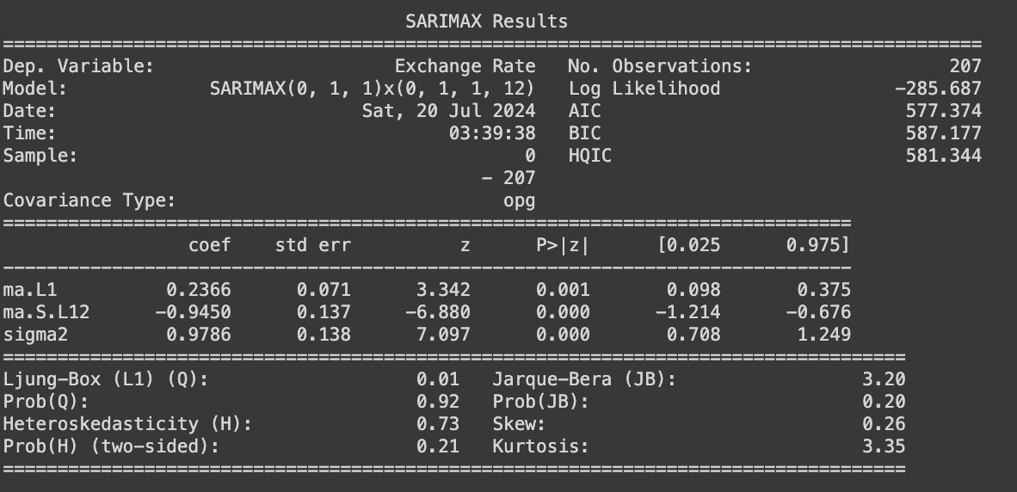
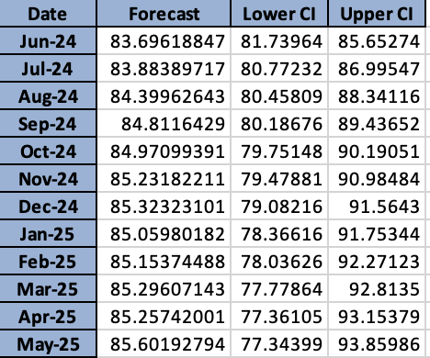
SARIMA MODEL and Forecasted Results
Microsoft Team 3
Notes:
Separate slide showing the actual vs predicted

Slide 25
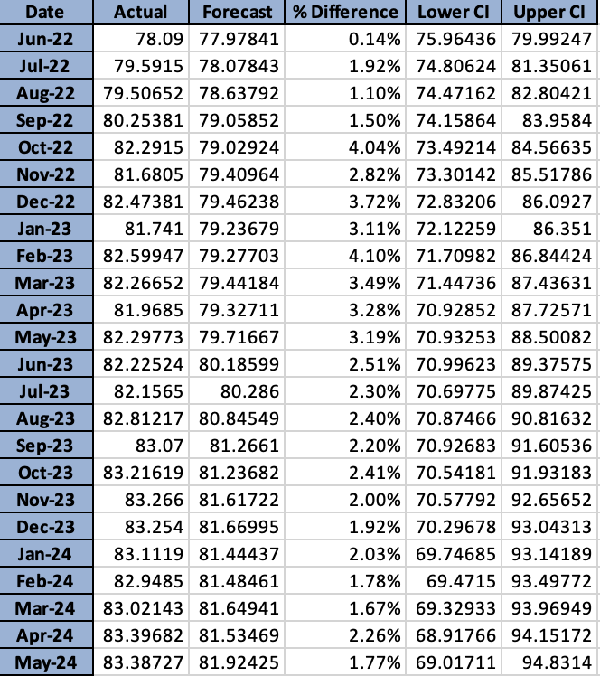
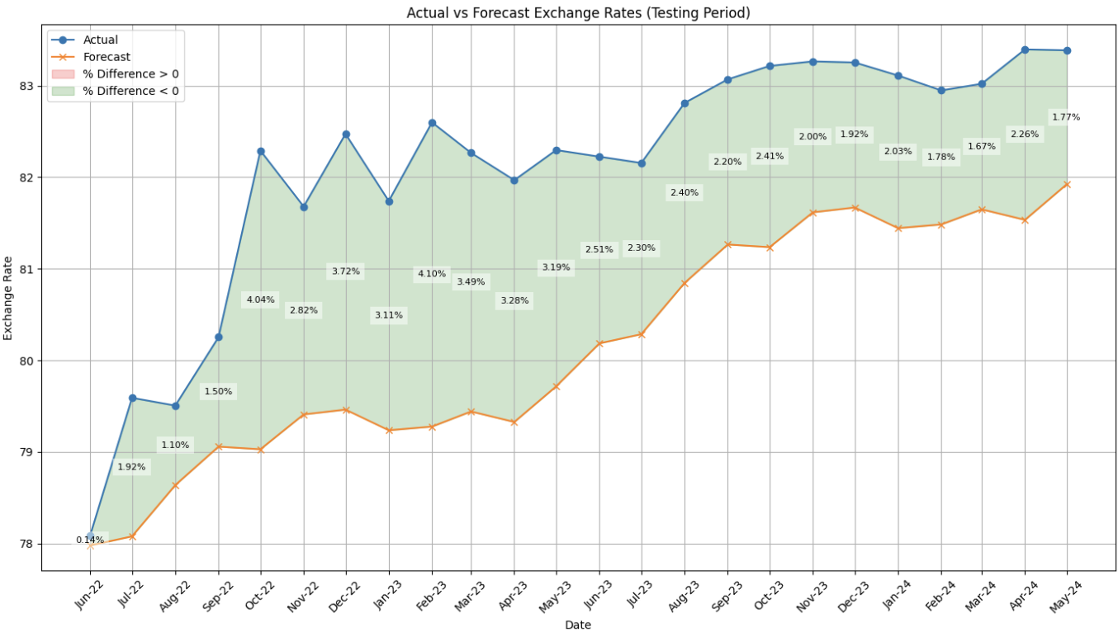
SARIMA Testing Period
Microsoft Team 3

Slide 26
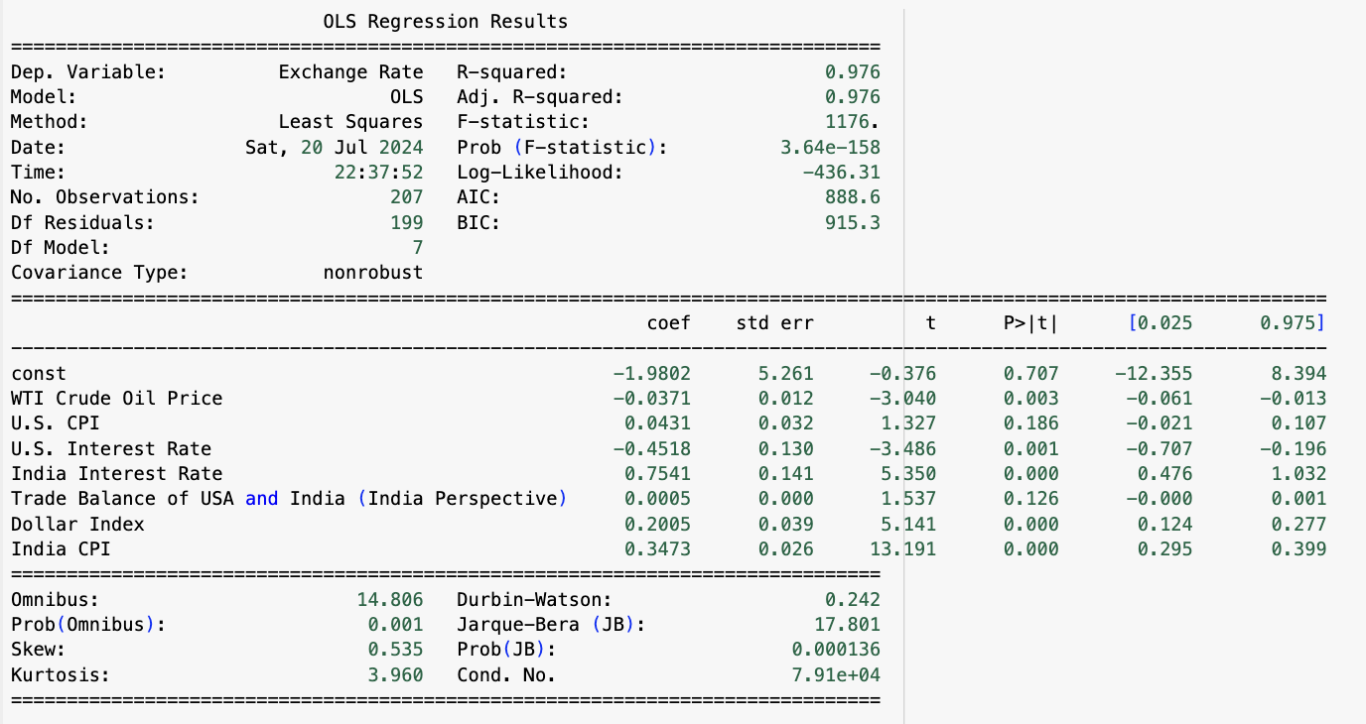
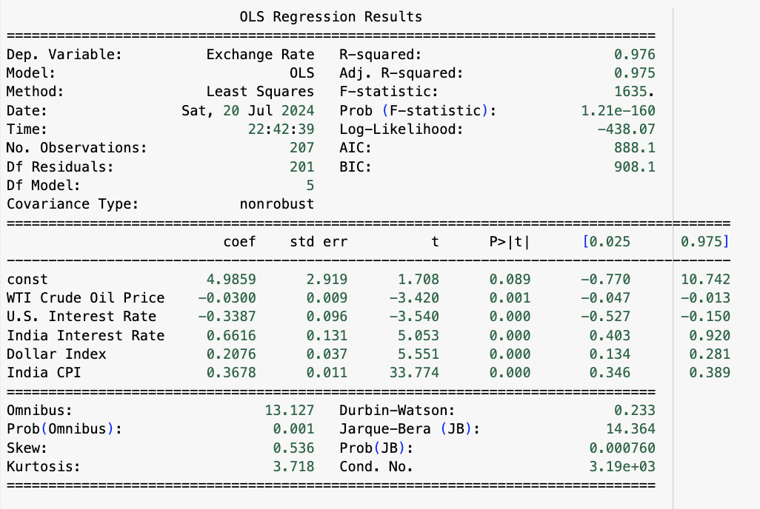
Regression Model OLS Results
Microsoft Team 3

Slide 27
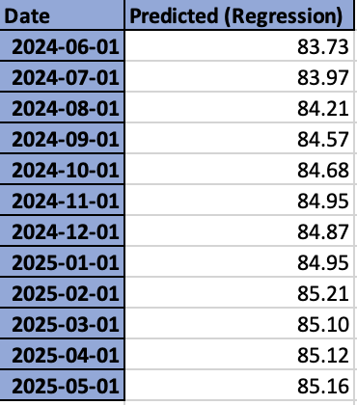
Regression Prediction

Slide 28
Pricing Change Scenario Analysis
(From January 2012 to July 2024)
Goal: Balance revenue dilution with frequency of price change
Banding (%) | 1% Threshold | 3% Threshold | 5% Threshold | 10% Threshold
1% | 6 | 5 | 4 | 3
2% | 5 | 4 | 3 | 2
3% | 4 | 3 | 3 | 1
4% | 4 | 2 | 2 | 1
5% | 3 | 2 | 1 | 1
Threshold | Banding | Revenue Dilution | Adjustment Frequency
10% | 5% | 5,000 | 1
Microsoft Team 3

Slide 29
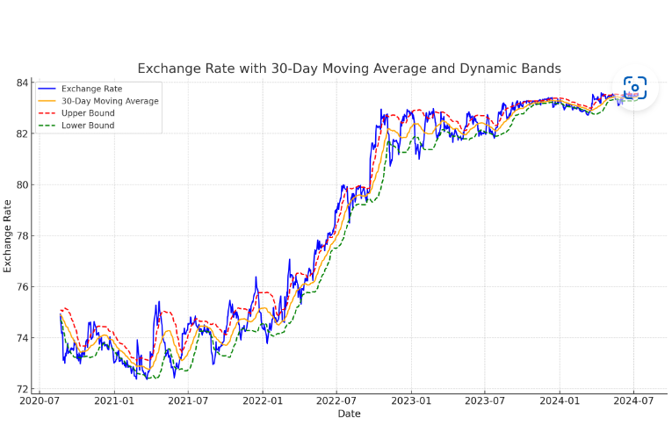
Banding and Threshold
Microsoft Team 3
Notes:
Mid avg

Slide 30
Pricing Change Scenario Analysis (In progress)
Banding | Number of Repricing Events
1% | 10
2% | 9
3% | 9
4% | 8
5% | 6
To achieve minimal repricing events while minimizing revenue dilution, our recommendation is to utilize a 5% band
Microsoft Team 3
Notes:
Predicted 2025

Slide 31
Pricing Change Scenario Analysis
(2007 to 2027)
Banding | Revenue Dilution (USD) | Frequency
1% | $61,660,660 | 51
2% | $53,231,860 | 34
3% | $49,621,190 | 24
4% | $51,281,310 | 14
5% | $51,306,120 | 10
3% Banding allows us to achieve lower revenue dilution without having excessive number of price changes
Microsoft Team 3
Notes:
Mid avg

Slide 32
Regression Influenced Indicators
Indicators | P-value | R^2
US CPI | <.0001 | 0.8553
India CPI | <.0001 | 0.94401
US GDP | <.0001 | 0.876802
Indian GDP | <.0001 | 0.901043
Dollar Index | <.0001 | 0.919958
P Values
Ranges from 0 - 1
Statistically Significant when Coefficients < .05
R^2 Values
Ranges from 0-1
Strong Data relationship with coefficient > .85
Microsoft Team 3

Slide 33
Why the Indian Rupee?
Financial Planning & Risk Management
Revenue & Profitability
Strategic Decision Making
Cash Flow Management
Hedging & Investment Decisions
Import Earnings
Export Costs
Pricing Strategy
Market Entry & Expansion
Supply chain Management
Microsoft Team 3
Notes:
Revenue and Profitability:
Import earnings and export costs
Financial Planning and Risk Management:
Cash flow management, hedging and investment decisions
Strategic Decision Making:
Pricing strategy, market entry & expansion, and supply chain management

Slide 34
Repricing Strategy
Determine pricing based on forecasted exchange rates
Evaluate for the range of pricing using the lower and upper CI
Determine impact on revenue when exchange rate is above vs below the forecasted
 | Average Ex Rate | Pricing (₹)
Forecast | 84.89053067 | 129288.2782
Lower CI | 79.19628 | 120615.9355
Upper CI | 90.58478 | 137960.621
Revenue Accretion (per Surface) | Revenue Dilution (per Surface)
109.5044 | -95.7373
Microsoft Team 3
Notes:
Notes
Now, to build off of our banding model, we will look at repricing strategy and draw some insights on how MSFT might respond when a repricing event is triggered
We determined the pricing of the surface product based on our forecasted exchange rates
For this model, we are looking at at the pricing of a single unit of the surface product
In addition, we’ve determined the upper and lower values for the surface pricing to provide an pessimistic pricing for when the exchange rate falls within the upper bound and an optimistic pricing when the exchange falls into the lower bound
Next, we have taken a look at the revenue accretion per surface product that occurs when the exchange rate is down and similarly on the other end, revenue dilution when the exchange rate is up

Slide 35
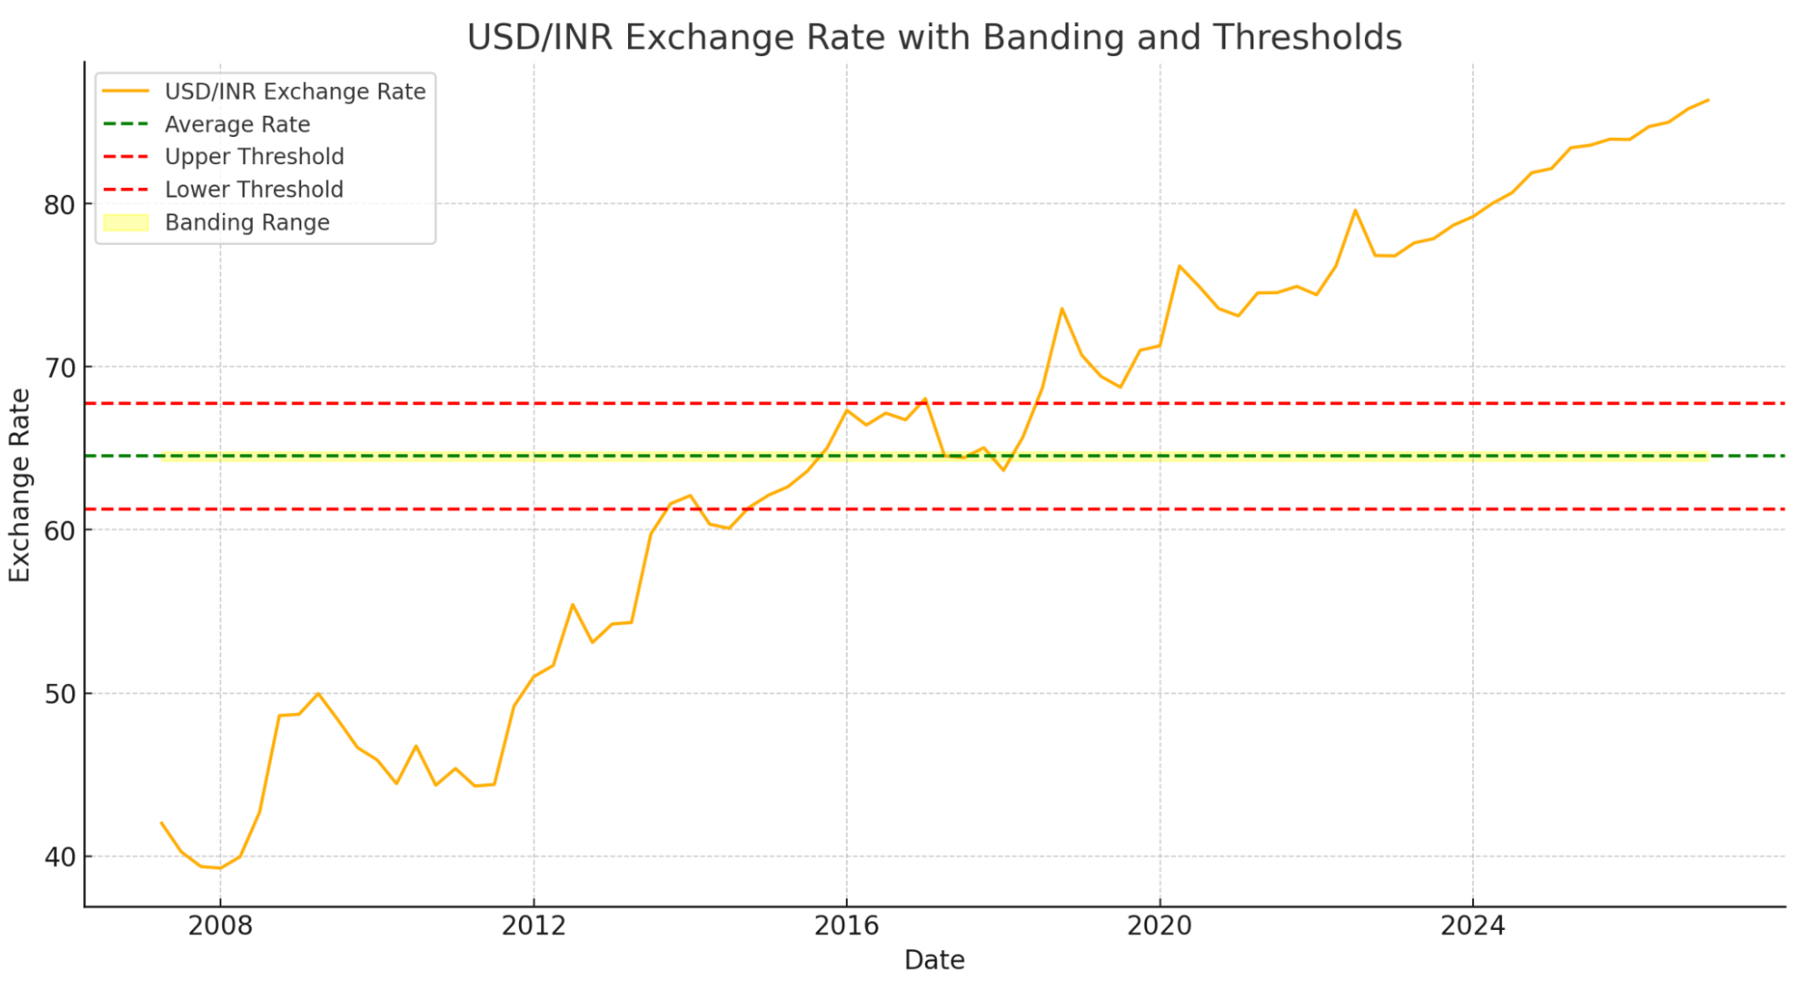
Banding & Threshold
Microsoft Team 3

Slide 36
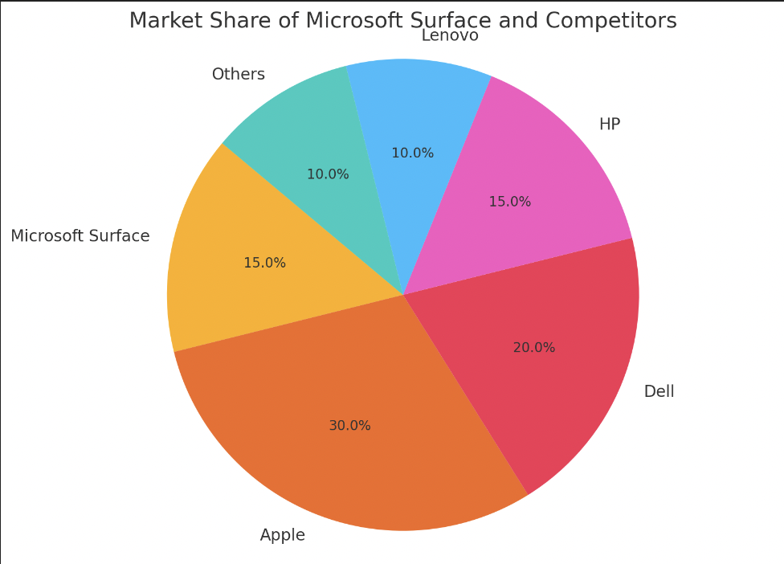
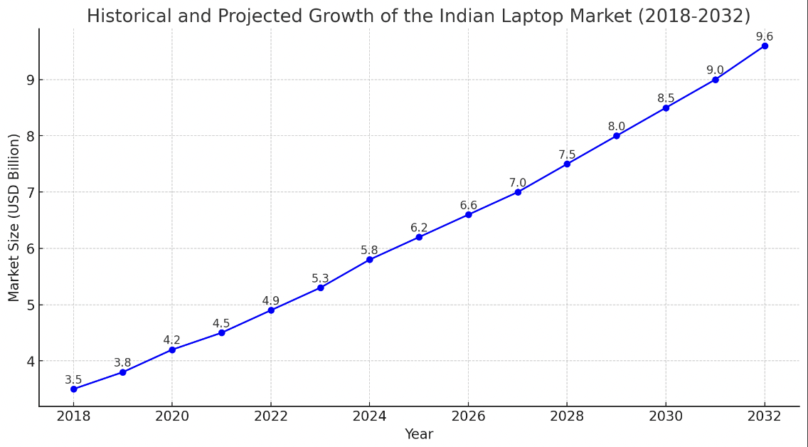
India’s Laptop industry
1
Market Share of the Microsoft Surface
15% of the global market share
Indian Market is more price-sensitive
Projected Growth of the Indian Laptop Market
15.1% Growth in 2 years
Current # Laptop users in India : 13.9 M
Projected # Laptop Users in 2026 : 16 M
2
Microsoft Team 3

